Slide 1
ASP.NET Model-View-Controller

Slide 2
Overview of material
Model-View-Controller design framework
MVC projects in Visual Studio
Controllers
URLs and routing in MVC
Views
Razor
Models
User controls
MVC Party invitations tutorial

Slide 3
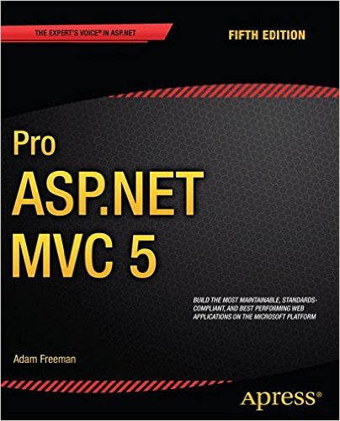
ASP.NET MVC resources
Recommended book:
Pro ASP.NET MVC5 by Adam Freeman
No good beginners’ books on MVC, but this is well-written and fairly accessible
Online tutorial: http://www.asp.net/mvc/overview/getting-started/introduction/getting-started
This has been updated, but is still MVC5. (Use this version, not the MVC Core version. Also, ignore the confusing introductory paragraph.)
In the database connection string, you may need to change (LocalDB)\v11.0 to (LocalDB)\MSSQLLocalDB
Also, look at Pluralsight videos
Scott Allen is good on MVC, but check that the video is MVC5, not an earlier one

Slide 4
WHAT IS MVC?

Slide 5
Goals of MVC?
Separation of concerns
Loose coupling (less dependency on other elements)
Coupling refers to the degree of direct knowledge that one element has of another.
Testable code
Clean URLS
Clean HTML
Align with HTTP model (stateless Request Response)
a stateless protocol does not require the server to retain session information or status about each communication
Improve code maintainability
Improve code readability

Slide 6
Model-View-Controller (MVC)
MVC is a Design Framework
Design frameworks are a way of organising code to solve a common problem
High-level architectural pattern - not a design pattern or an algorithm
To split up your code into layers, where each layer has a certain responsibility and provides a service to a higher layer.
Easier for other developers to understand your code
Model-View-Controller
Used to manage software with a graphical user interface – popular on web
Separates code into distinct areas and manages the interactions between them
Not exclusive to ASP.NET
e.g. JavaMVC, JavaScriptMVC and others exist

Slide 7
MVC
M odels: Classes that represent the data of the application and that use validation logic to enforce business rules for that data.
V iews: Template files that your application uses to dynamically generate HTML responses. (GUI)
C ontrollers: Classes that handle incoming browser requests, retrieve model data, and then specify view templates that return a response to the browser.

Slide 8
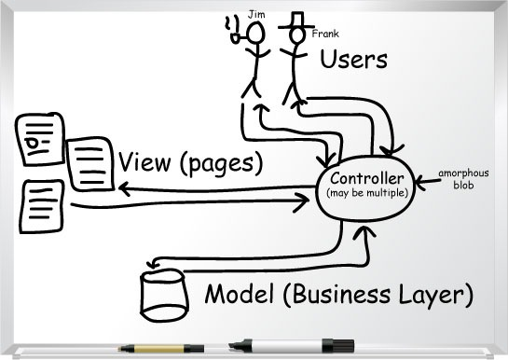
Model-View-Controller (MVC)
Code divided into 3 parts
Model
Holds objects and data
Links to database
View
Displays GUI to user
Controller
Responds to communications from user
Calls views
Retrieves data from model
Contains program logic

Slide 9

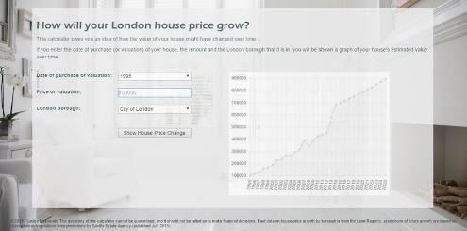
MVC example
House price calculator
Model
Contains data on price changes for each borough
Contains objects
Links to database
View
Screens
Controller
Calls views
Queries and updates DB
Does calculations
Home
Controller
Graphs
Controller
Model

Slide 10
ASP.NET MVC
Implemented in Visual Studio
We will use ASP.NET MVC 5
ASP.NET Core ( = ASP.NET 5 and MVC 6) has been released, but we won’t be using it in class until there is demand for them from employers
Uses C#, HTML, CSS, JavaScript and Bootstrap
Also uses Razor for Views
Razor is an ASP.NET programming syntax used to create dynamic web pages with the C# or VB.NET.
Open source with public repository

Slide 11
HTTP Response
Routing engine
HTTP Request
The process of directing an HTTP request to a controller and correct method in the controller is known as routing.
View
Holds data
Holds state
Controller
Controllers are responsible for
Talk to database and build model to pass to a view
Select view to render the model
Pass the model data to the view
Model
The job of most controllers is to assemble some sort of model and put it into the view data then pass it through to the view for the view to then present it on the page
Holds data
Holds state
The correct controller and method is identified and the Action Invoker then executed Actions on the HTTP request and determine the final destination.

Slide 12
Creating MVC Project

Slide 13
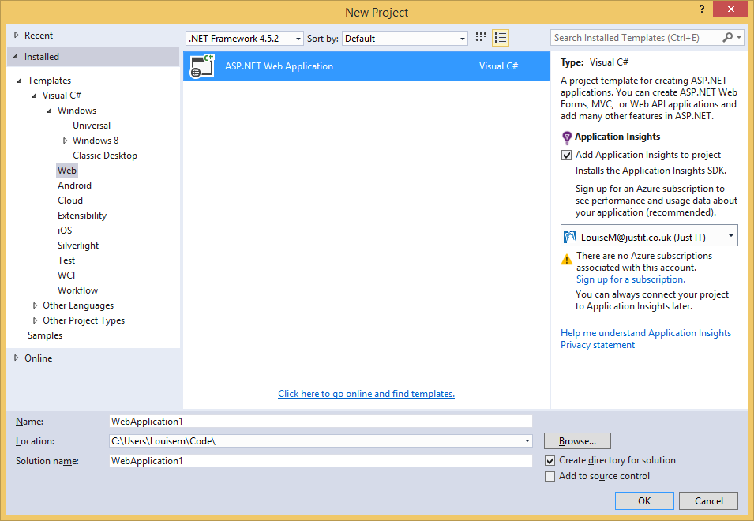
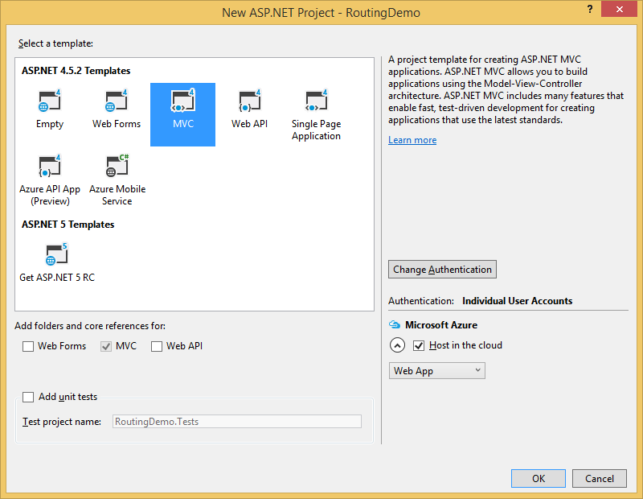

Slide 14
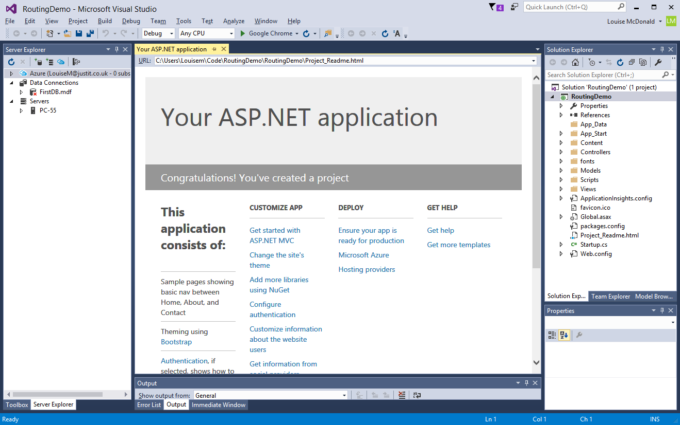

Slide 15
Routing

Slide 16
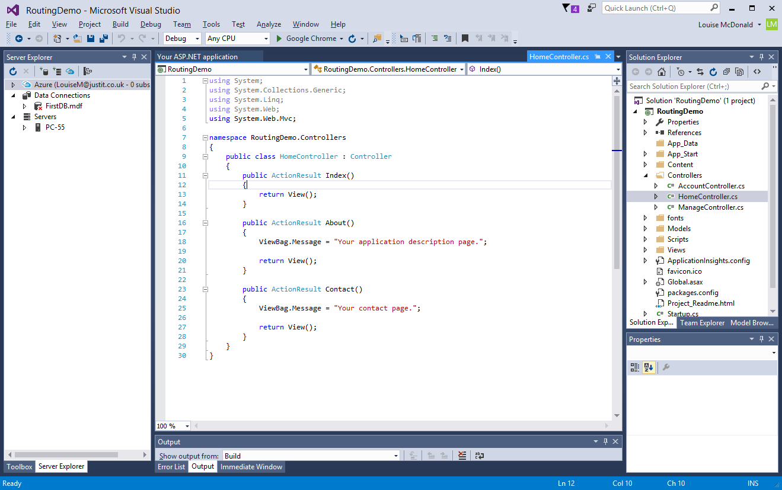
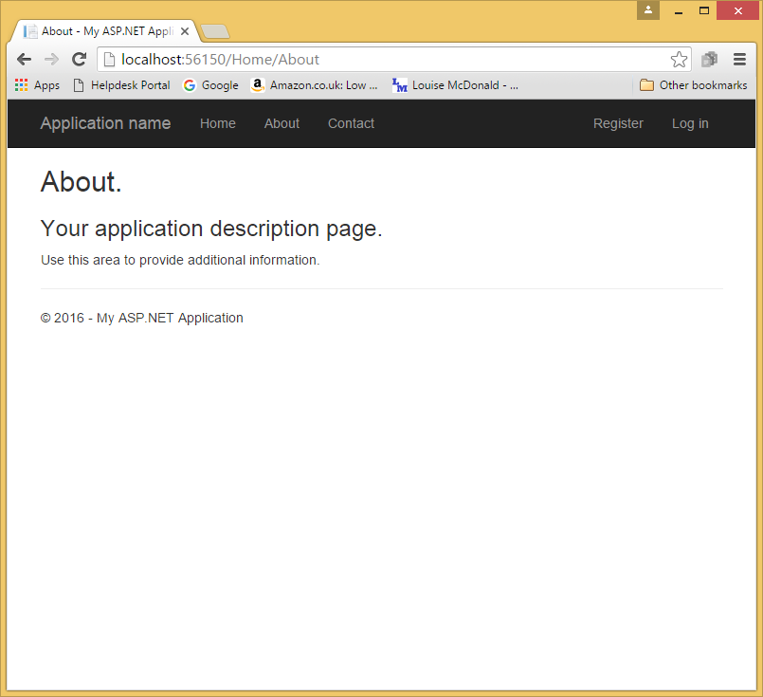
MVC – routing – controller and methods
If you only type the name of the controller, you get the Index method
Notes:
In MVC, where is the driving seat? It’s the controller, which responds to URLs
Try this out – type into the URL and see what happens. Also, use the navigation bar to change pages and see what happens to the URL

Slide 17
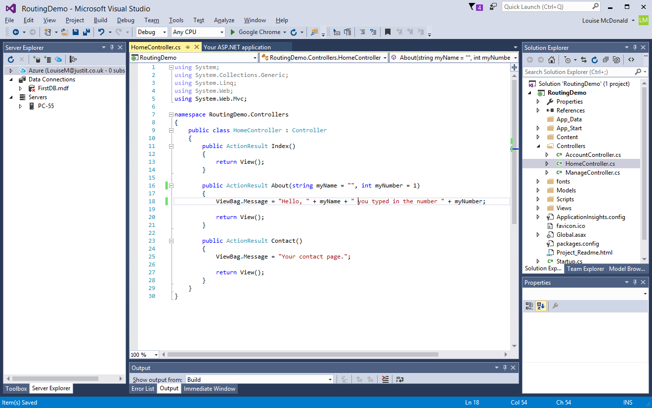
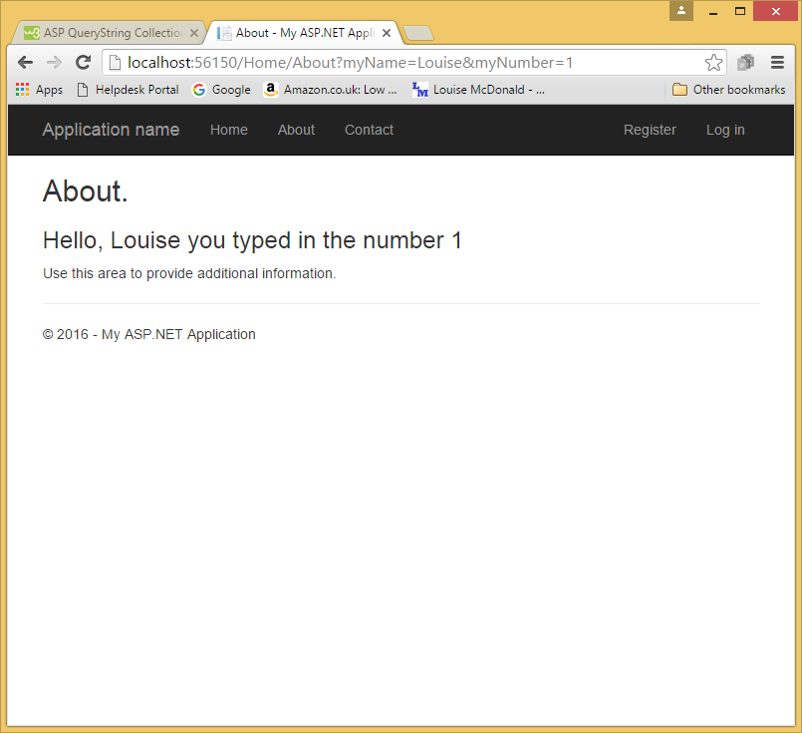
MVC – routing – parameters & query strings
Notes:
Try this out

Slide 18
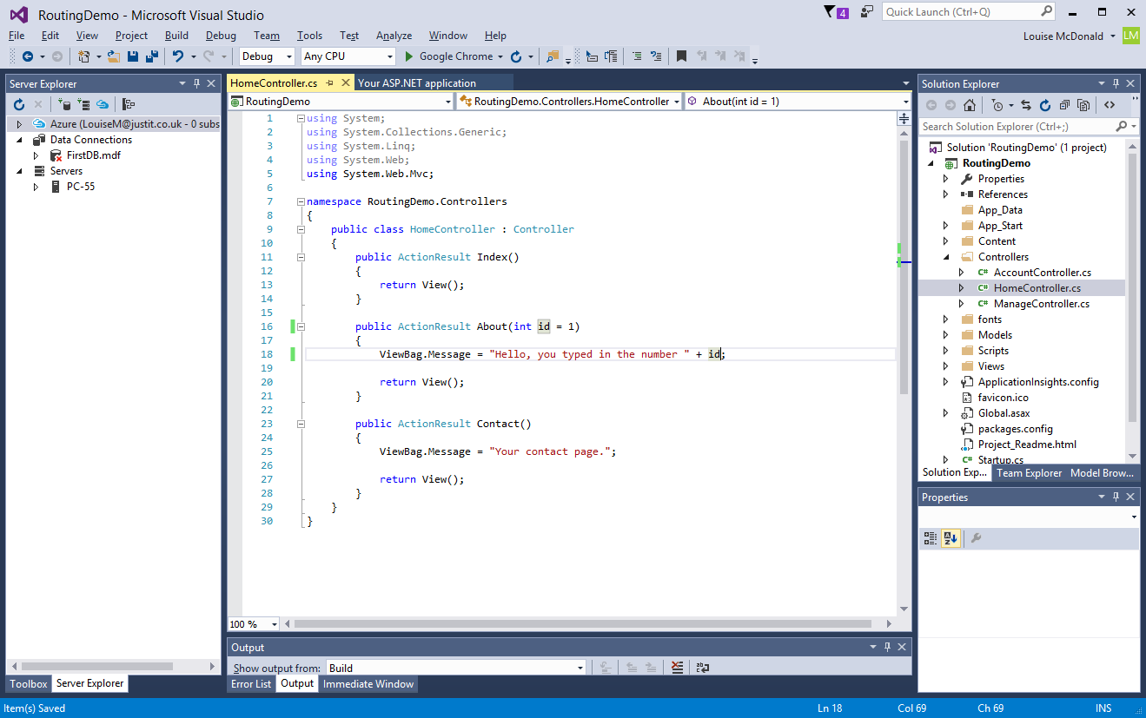
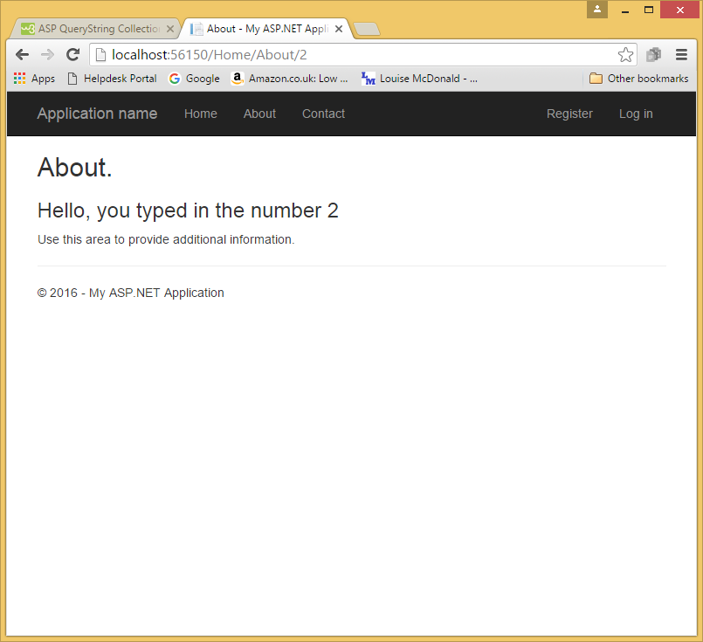
MVC – routing – ID parameter
One of MVC’s default routing conventions is to pick up any variable that corresponds to a parameter called ID and pass it into the action method being called
Notes:
Try this out – could fix it by restoring the string parameter and making the URL /3?name=Louise

Slide 19
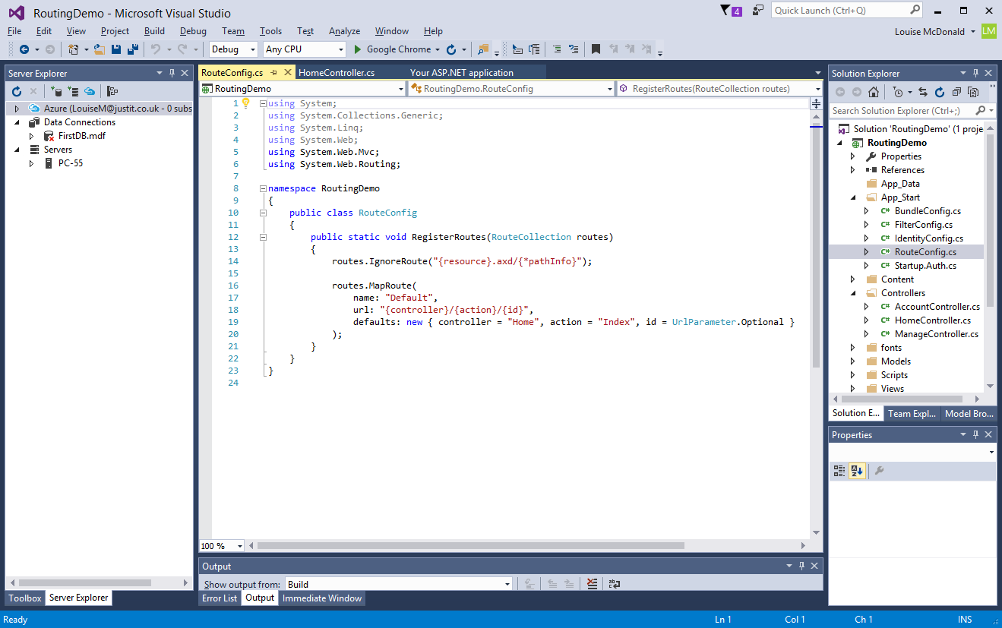
MVC – routing – RouteConfig.cs

Slide 20
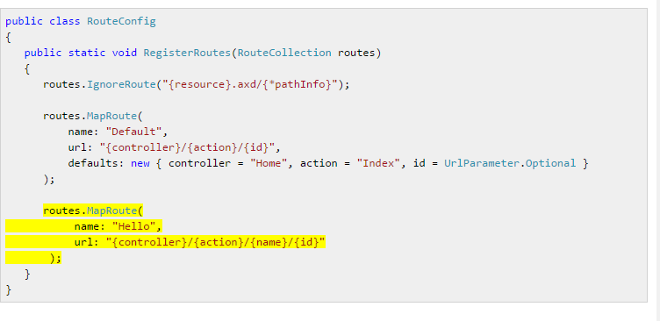
MVC – routing – adding another route

Slide 21
MVC CONVENTIONS

Slide 22

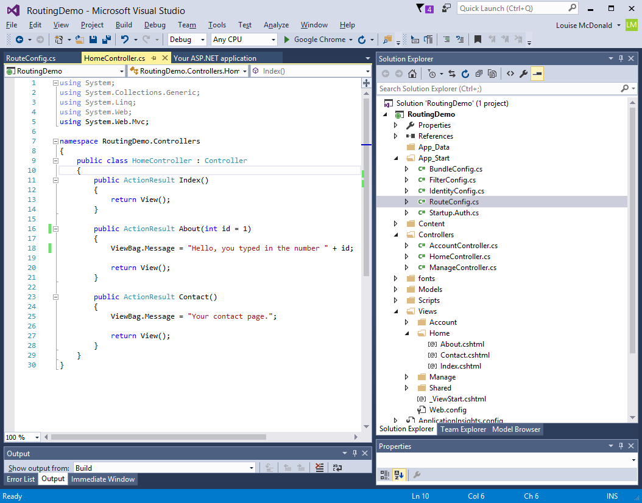
MVC conventions
‘Convention over configuration’
Controllers and Action Methods map to URLs
Each controller’s class name ends with Controller
But the ‘Controller’ bit is dropped from paths
Controllers look for views in the \Views\[ControllerName] folder
View names usually match the Action Method that calls them
Only one Views folder and all views are in it
Possible to override conventions, but avoid this for now

Slide 23
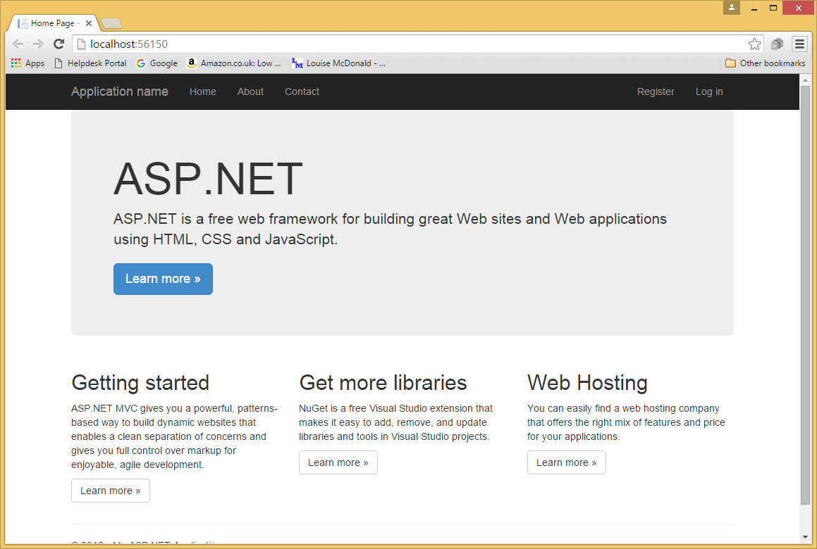
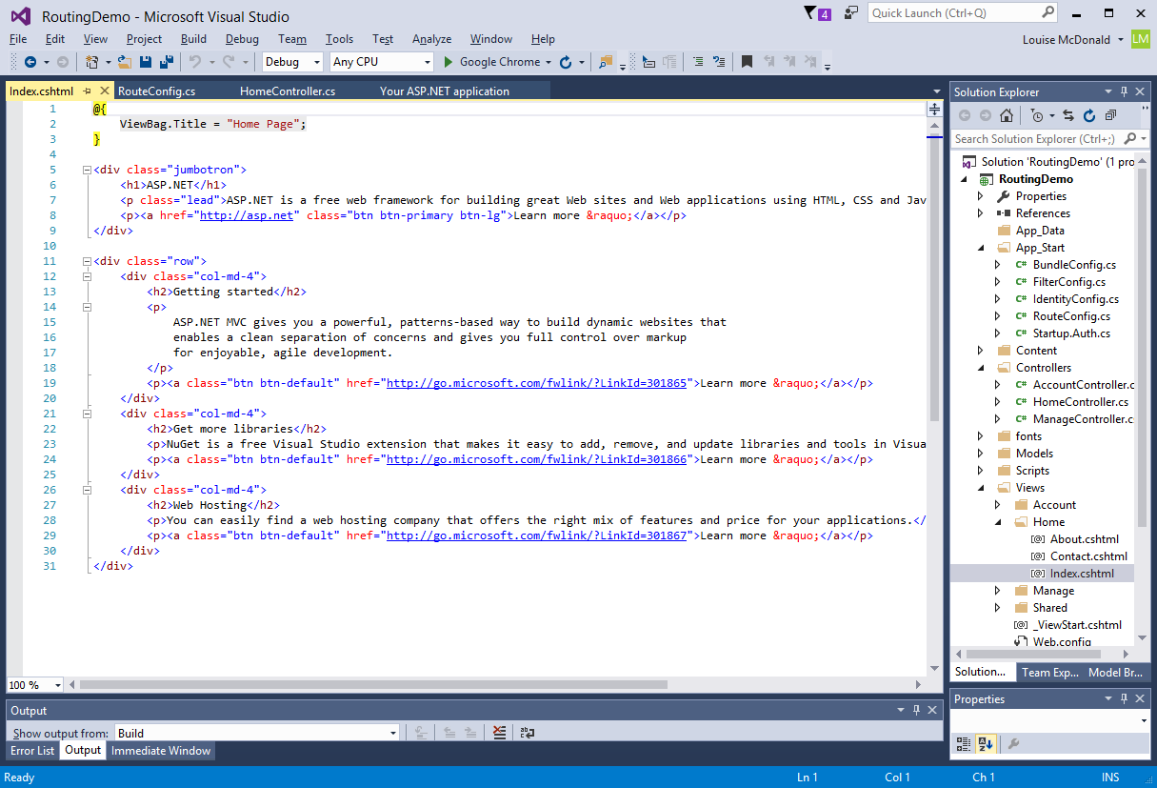
MVC - views
Responsible for user interface
Views are rendered by controllers
Can’t navigate to a view
Controllers provide data to views
Use a data transfer object called a model
Views often contain a mixture of HTML, C# and Razor
Notes:
Look at the code – what is familiar? What is unfamiliar? Now try to match up the code to what you are seeing on the webpage – does it match up? Is there anything missing?

Slide 24
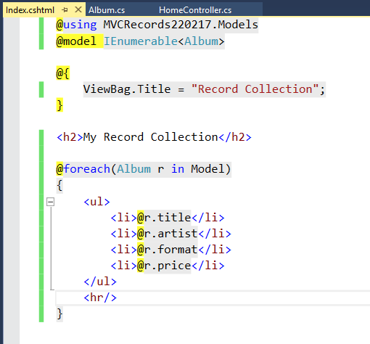
MVC – views - Razor
Clean, lightweight, simple view engine
Contrasts with the syntactic clutter of WebForms
Razor understands the structure of markup and does a lot of work for you
@ symbol marks transitions between C# and HTML
Works for expressions and blocks
Use () to resolve any ambiguities
@@ escapes the @ symbol
@* *@ for comments

Slide 25
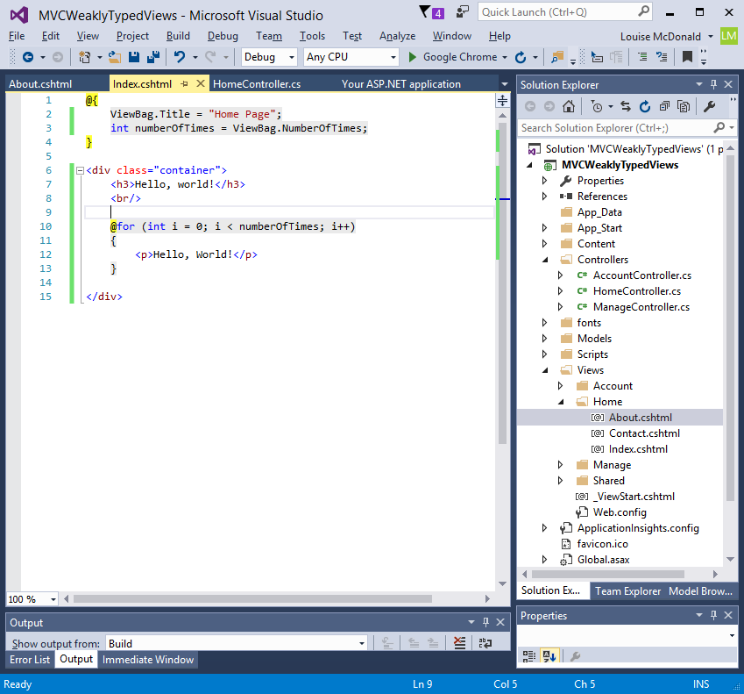
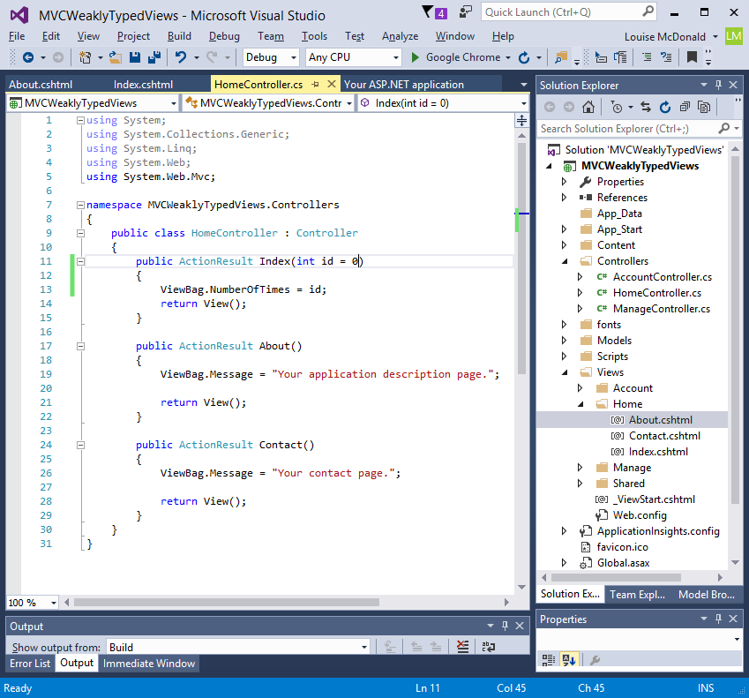
MVC –view example
Example of passing data through a controller to a view
ViewBag is a dictionary
Use ViewBag.[name] to pass a variable by name to a view
Same as ViewData[“name”]
Not strongly typed, so can cause problems
Only persists for one render (can’t be used for redirects – use TempData)
TempData is useful when you want to transfer non-sensitive data from one action method to another action method of the same or a different controller as well as redirects.
A view that doesn’t contain a model reference is said to be weakly typed
MVC Weakly Typed Views

Slide 26
MVC CONVENTIONS

Slide 27
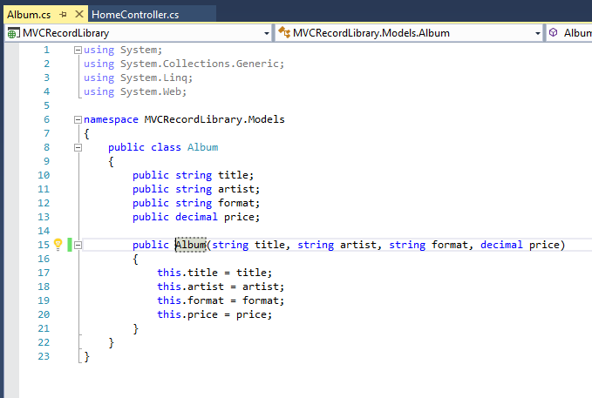
MVC - model
The model contains the classes that you will use for data
All these classes go in the Models folder
When we add a database, this will add classes to the Models folder

Slide 28
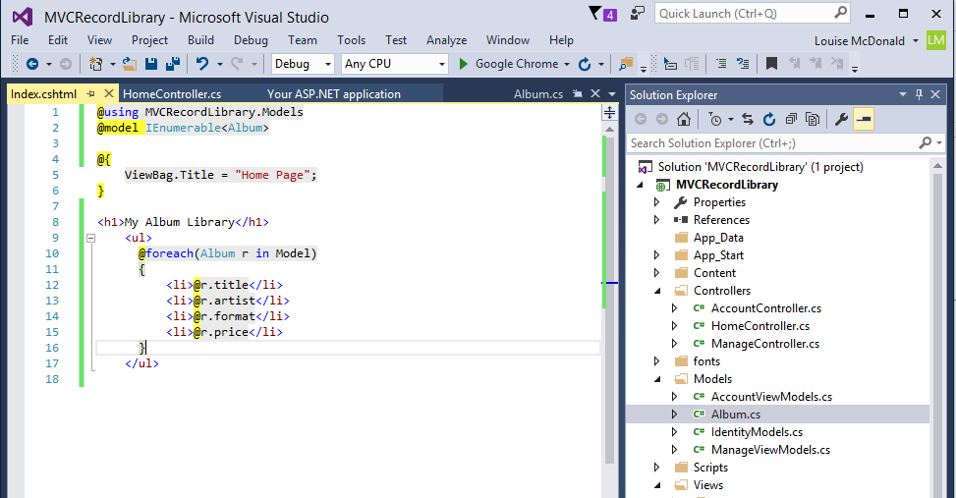

MVC – strongly typed views
Strongly typed views are best
These make sure you stay consistent with the model
They make Intellisense available to help you
IEnumerable is the base interface for all non-generic collections that can be enumerated.
IEnumerator provides the ability to iterate through the collection by exposing a Current property and MoveNext and Reset methods.

Slide 29
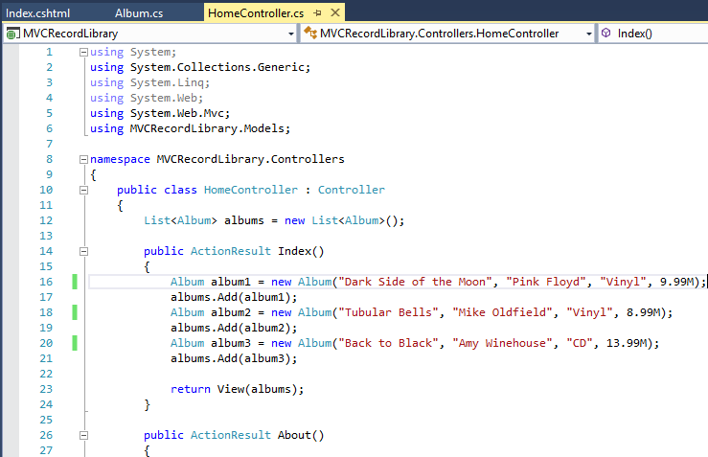
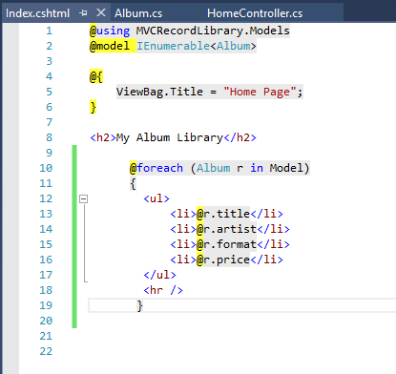
MVC – strongly typed views example
Notes:
Create your own version of this

Slide 30
MVC CONVENTIONS

Slide 31
Main Razor Syntax Rules for C#
Razor is a simple programming syntax for embedding server code in web pages.
Razor code blocks are enclosed in @{ ... }
Inline expressions (variables and functions) start with @
Code statements end with semicolon
Variables are declared with the var keyword
Strings are enclosed with quotation marks
C# code is case sensitive
C# files have the extension .cshtml
@{ var myMessage = "Hello World"; }
<p>The value of myMessage is: @myMessage</p>
<td>Day</td><td>@DateTime.Now.Day</td>

Slide 32
MVC – user controls
Easiest to create them with HTML helpers
These produce HTML and help with passing information between views and controllers
Html helpers are only used in Views
@Html.BeginForm
@Html.Label
@Html.TextBox
@Html.Editor
@Html.RadioButton
@Html.CheckBox
Overloaded methods, so can have different sets of parameters

Slide 33
MVC and databases
Databases are a real strength of MVC
MVC does a huge amount of the work for you
We are going to create a version of the code in this online tutorial: http://www.asp.net/mvc/overview/getting-started/introduction/getting-started
The tutorial uses a lot of generated code, but we will code from scratch
For now, some error checking and validation will be left out, so the most important code is clear
Working through the tutorial later is recommended

Slide 34
Projects
Now you should start thinking about your second project
Your second project can be more challenging, but should still be realistic
Use a database, but only one table
Deploy a working version to the web
It must have CRUD functionality – Create, Read, Update, Delete
Don’t get too complex – e-commerce or multi-table databases are way too much at this stage

Slide 35
Using the ASP.NET MVC book
This is the most accessible MVC book that I have found
MVC is professional-level coding and there isn’t really much beginners’ material
Chapter 1 is good background
Chapter 2 has an excellent introductory tutorial
Chapter 3 compares MVC to other architectures and introduces unit testing
Skip the section on loosely coupled components – dependency injection is an advanced topic that you don’t need for your projects
Before going any further, I would recommend working through the online MVC Movies tutorial at https://docs.microsoft.com/en-us/aspnet/mvc/overview/getting-started/introduction/getting-started
Use this version, not the updated one
In the database connection string, change v11.0 to MSSQLLocalDB
This tutorial is good preparation for a second project

Slide 36
Using the ASP.NET MVC book
Chapter 4 goes into extension methods, dependency injection and some other topics that are beyond the scope of the course
Feel free to skip this
Chapter 5 introduces Razor – this is important, so worth working through
Chapter 6 covers some advanced topics
Only work through it if you are planning to do the e-commerce tutorial
Chapter 7-12 cover an e-commerce tutorial
This is quite helpful for third projects, but over-complicated, as it includes dependency injection and other advanced topics
The online Contoso University is a good alternative as a preparation for third projects: https://docs.microsoft.com/en-us/aspnet/mvc/overview/getting-started/getting-started-with-ef-using-mvc/creating-an-entity-framework-data-model-for-an-asp-net-mvc-application

Slide 37
Using the ASP.NET MVC book
Chapter 13 is about Azure deployment
You can skip this if you don’t want to use Azure
We recommend a different service and provide detailed guidance on how to deploy
The remaining chapters are quite helpful on various aspects of MVC (and not as scary as the e-commerce tutorial)

Slide 38
MVC tips
ViewBag data only survives for one render and is then cleared
Use TempData[“VariableName”] if you want data to survive for a redirect
You can also pass data through the query string
This StackOverflow answer is really clear and helpful: https://stackoverflow.com/questions/19294975/why-isnt-viewbag-value-passing-back-to-the-view

Slide 39
HTTP Response
Routing engine
HTTP Request
The process of directing an HTTP request to a controller and correct method in the controller is known as routing.
View
Holds data
Holds state
Controller
Controllers are responsible for
Talk to database and build model to pass to a view
Select view to render the model
Pass the model data to the view
Model
The job of most controllers is to assemble some sort of model and put it into the view data then pass it through to the view for the view to then present it on the page
Holds data
Holds state
The correct controller and method is identified and the Action Invoker then executed Actions on the HTTP request and determine the final destination.

Slide 40
Shopping Cart
HTTP Response
HTTP Request
Model
Controller
View
Product Class
ID
Name
Description
Price
Cart Class
Cart List
Create products
Store in Cart List
Pass to view
Display products

Slide 41
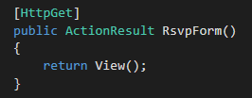
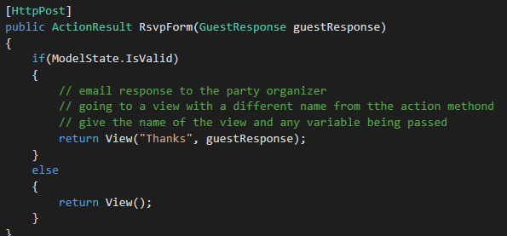
Party Invitation Form
Model
Guest Response
Name
Email
Phone
Will Attend
Controller
View
/Home/RSVP Form
Display products
HTTP Request
HTTP Response
/Home/Thanks

Slide 42
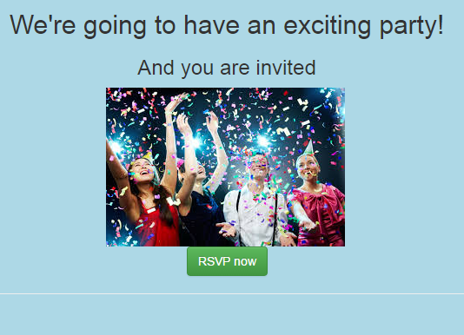
MVC Party Invitations tutorial
Freeman book, chapter 2
Good introduction to MVC
Form
User controls
Linking between pages
Validating user input
Sending email

